Slide 1

PROTOTYPE OF CHILLI PLANTS AUTOMATION SYSTEM IN IOT-BASED SMART GREENBOX
Ikram Andika Ukar
1101181299
ADVISOR I
Dr. Nyoman Bogi Aditya Karna, S.T., MSEE.
NIP. 11730049
ADVISOR II
Sussi, S.Si., M.T.
NIP. 15830014

Slide 2





OUTLINE
Introduction
Design and Realization
Performance Analysis
Conclusions & Suggestions

Slide 3
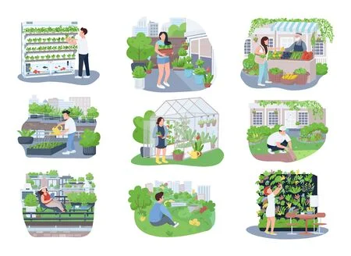

Introduction
Backgrounds
Most of today's urban people are busy working outside the home all day.
Indoor farming is one of the hobbies of today's urban people, but often the plants are not well-maintained.

Slide 4
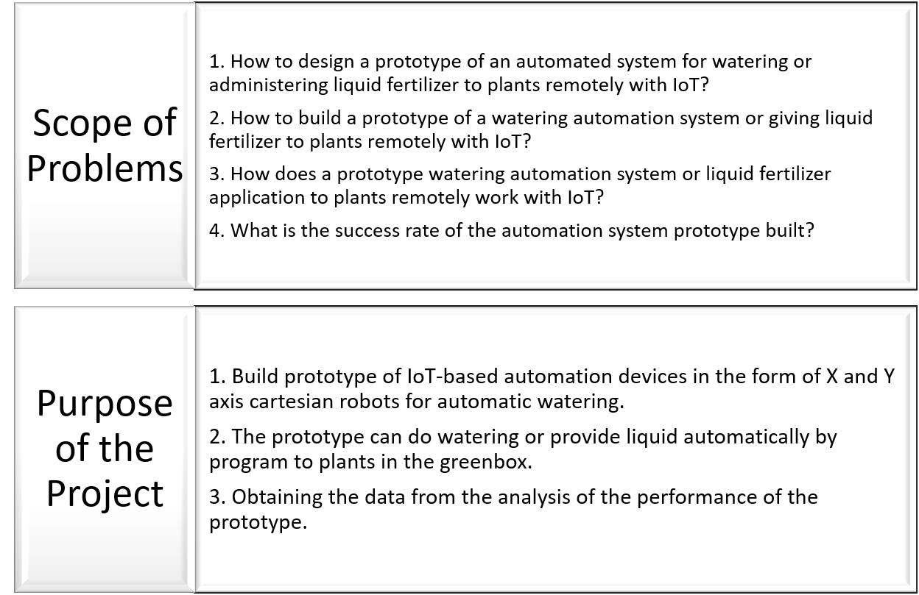
Introduction
Problems

Slide 5
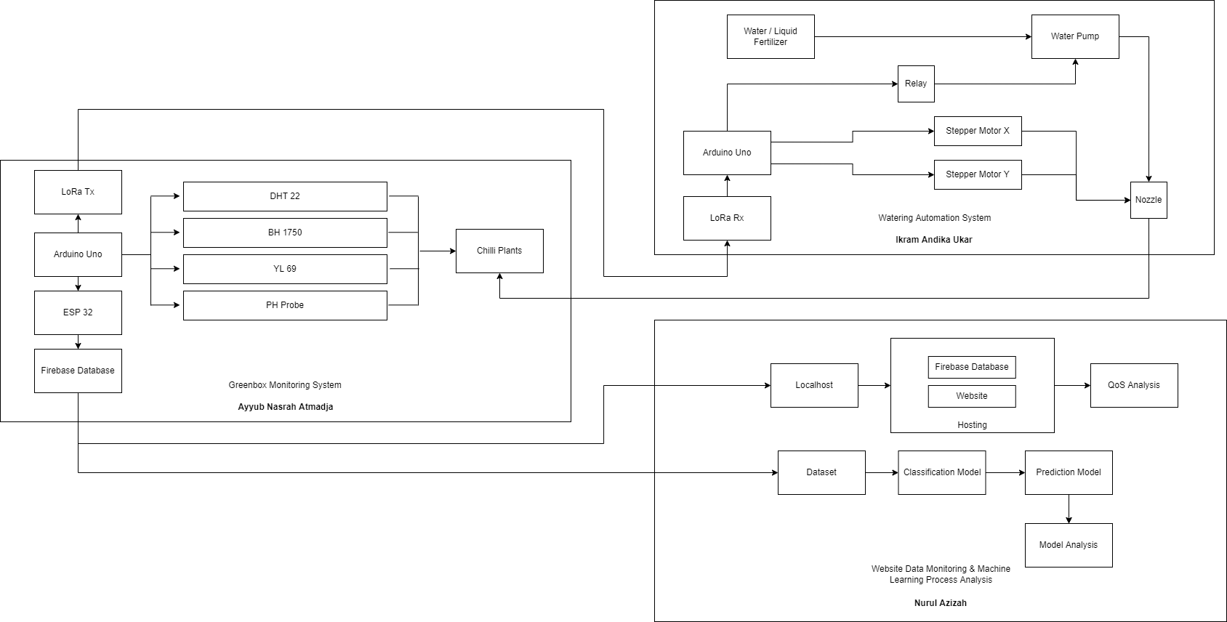
Design and Realization
Smart Greenhouse Block Diagram

Slide 6
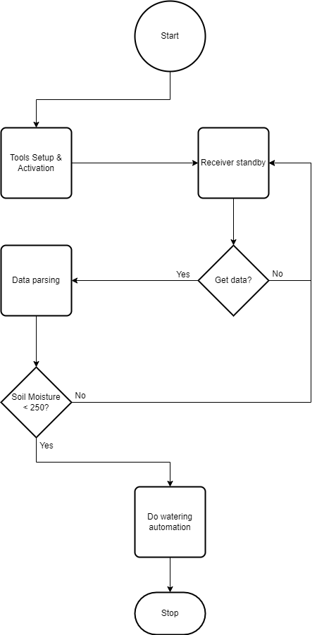
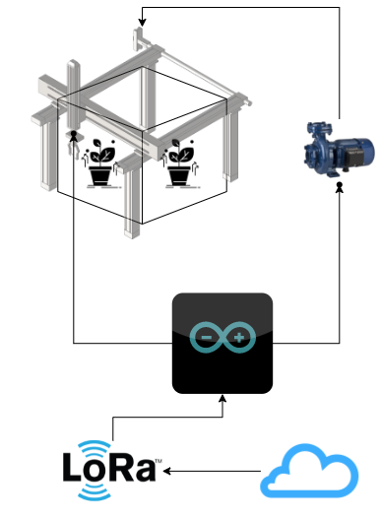
Design and Realization
Manufacture Process & Prototype Procedures
Designing the frame with the size and electrical circuit
Collecting tools and materials
Installing X-Y axis CNC machine frame
Installing iron frame
Connecting CNC machine frame with iron frame
Installing watering components
Connecting Arduino Uno with other components
Programming
Finishing and testing

Slide 7
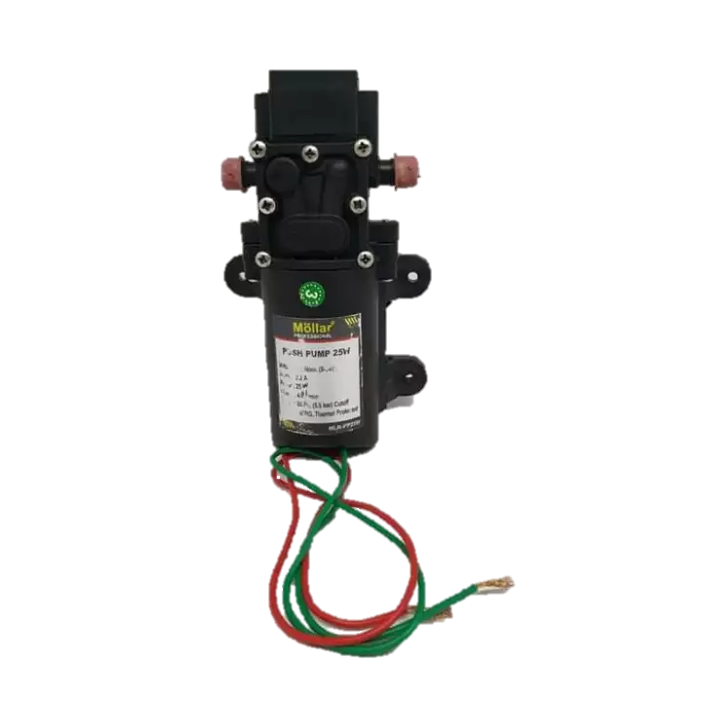
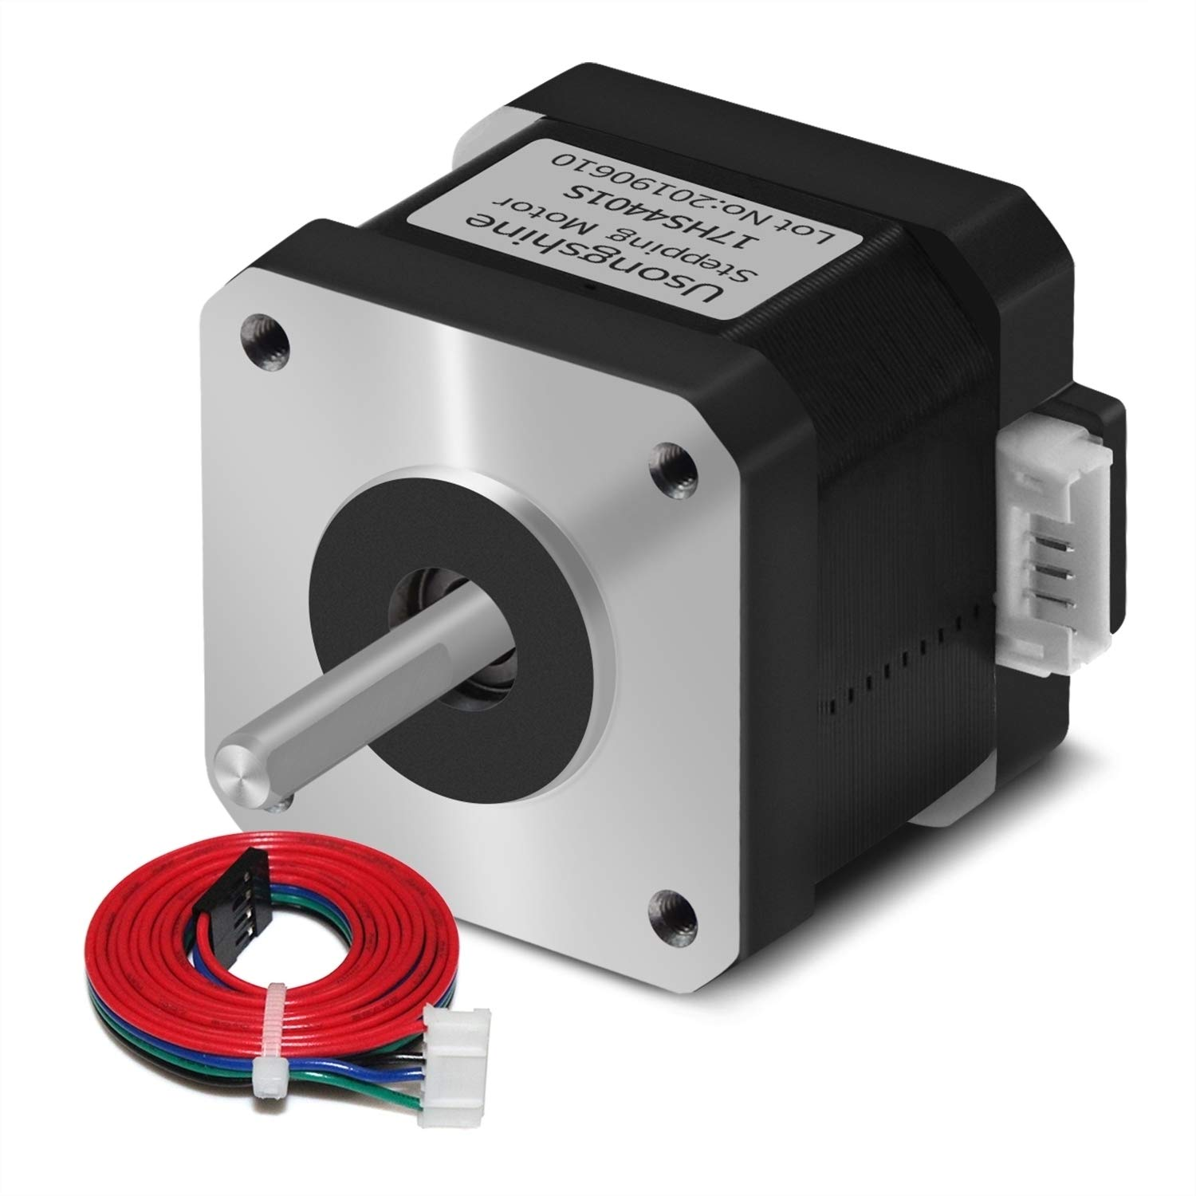
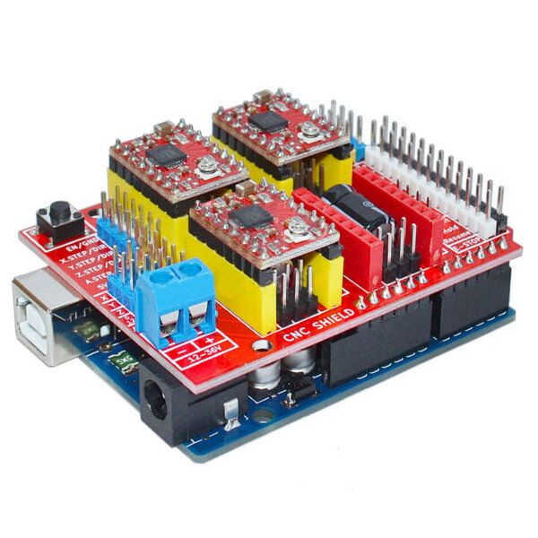
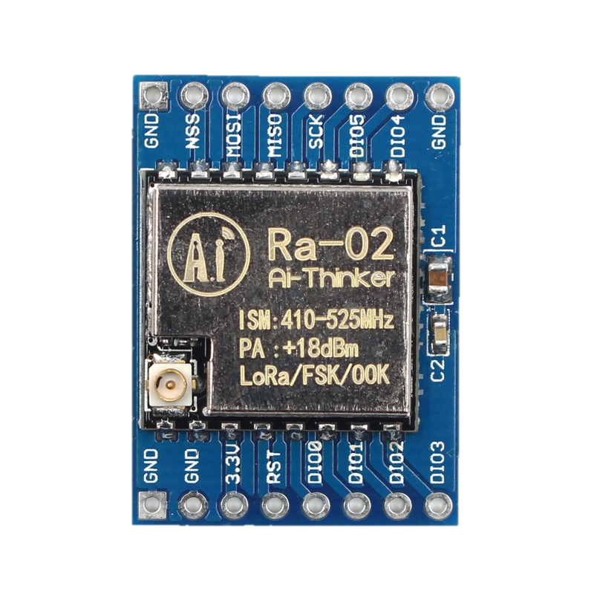
Design and Realization
Main Electrical Components

Slide 8
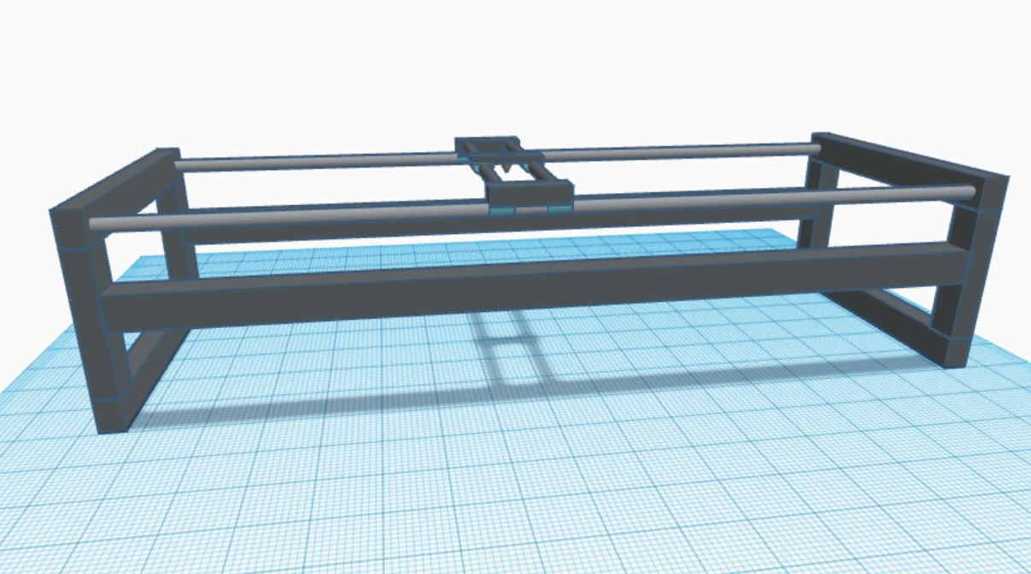
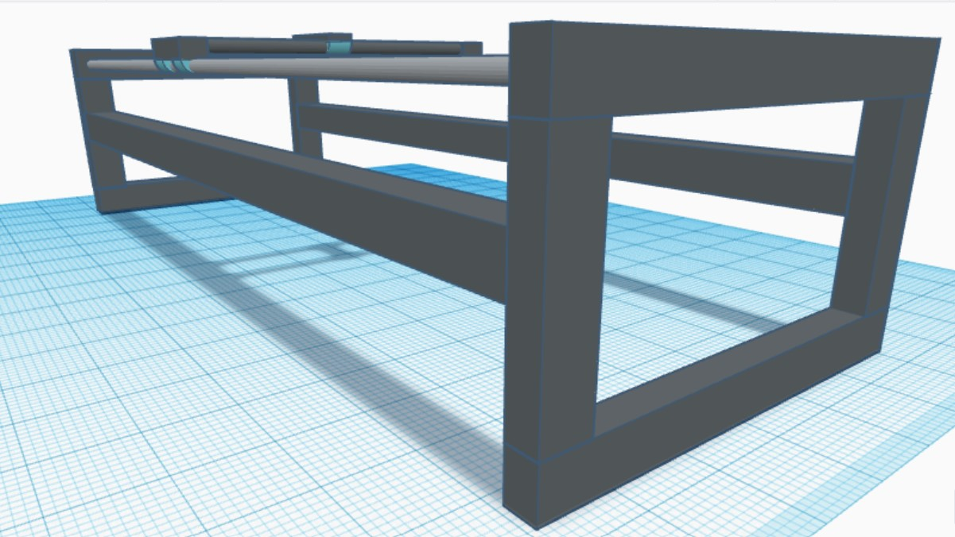
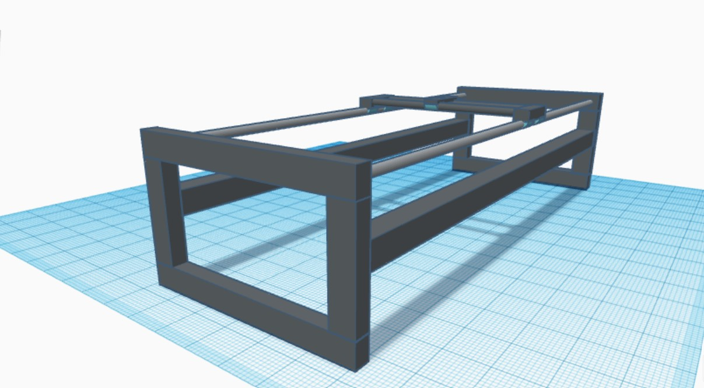
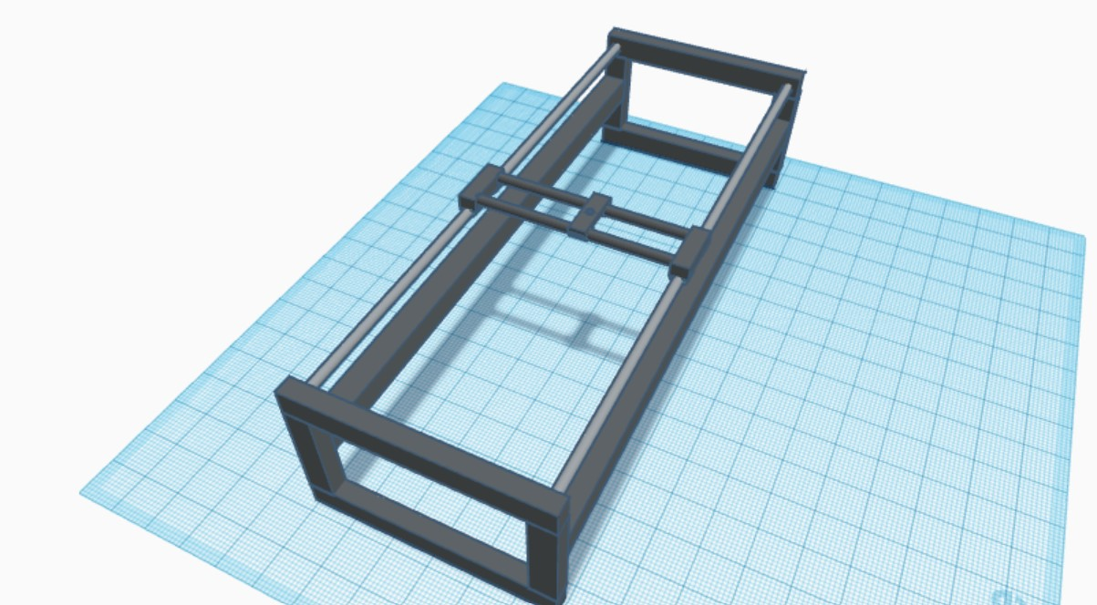
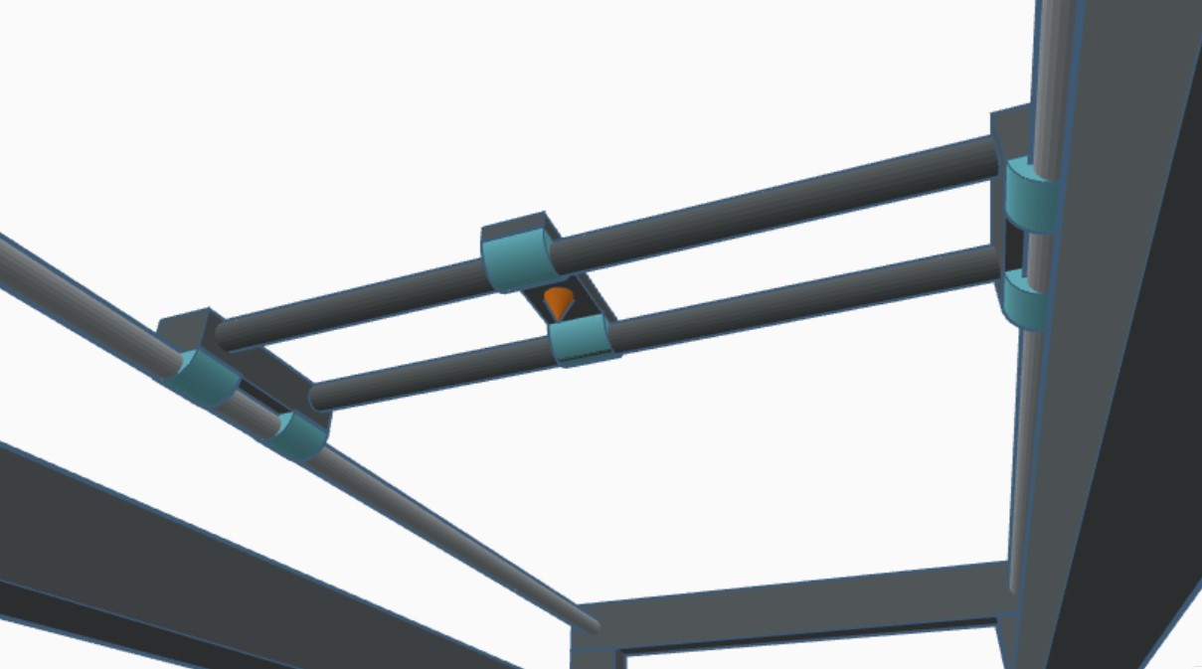
Design and Realization
Prototype Frame Design

Slide 9
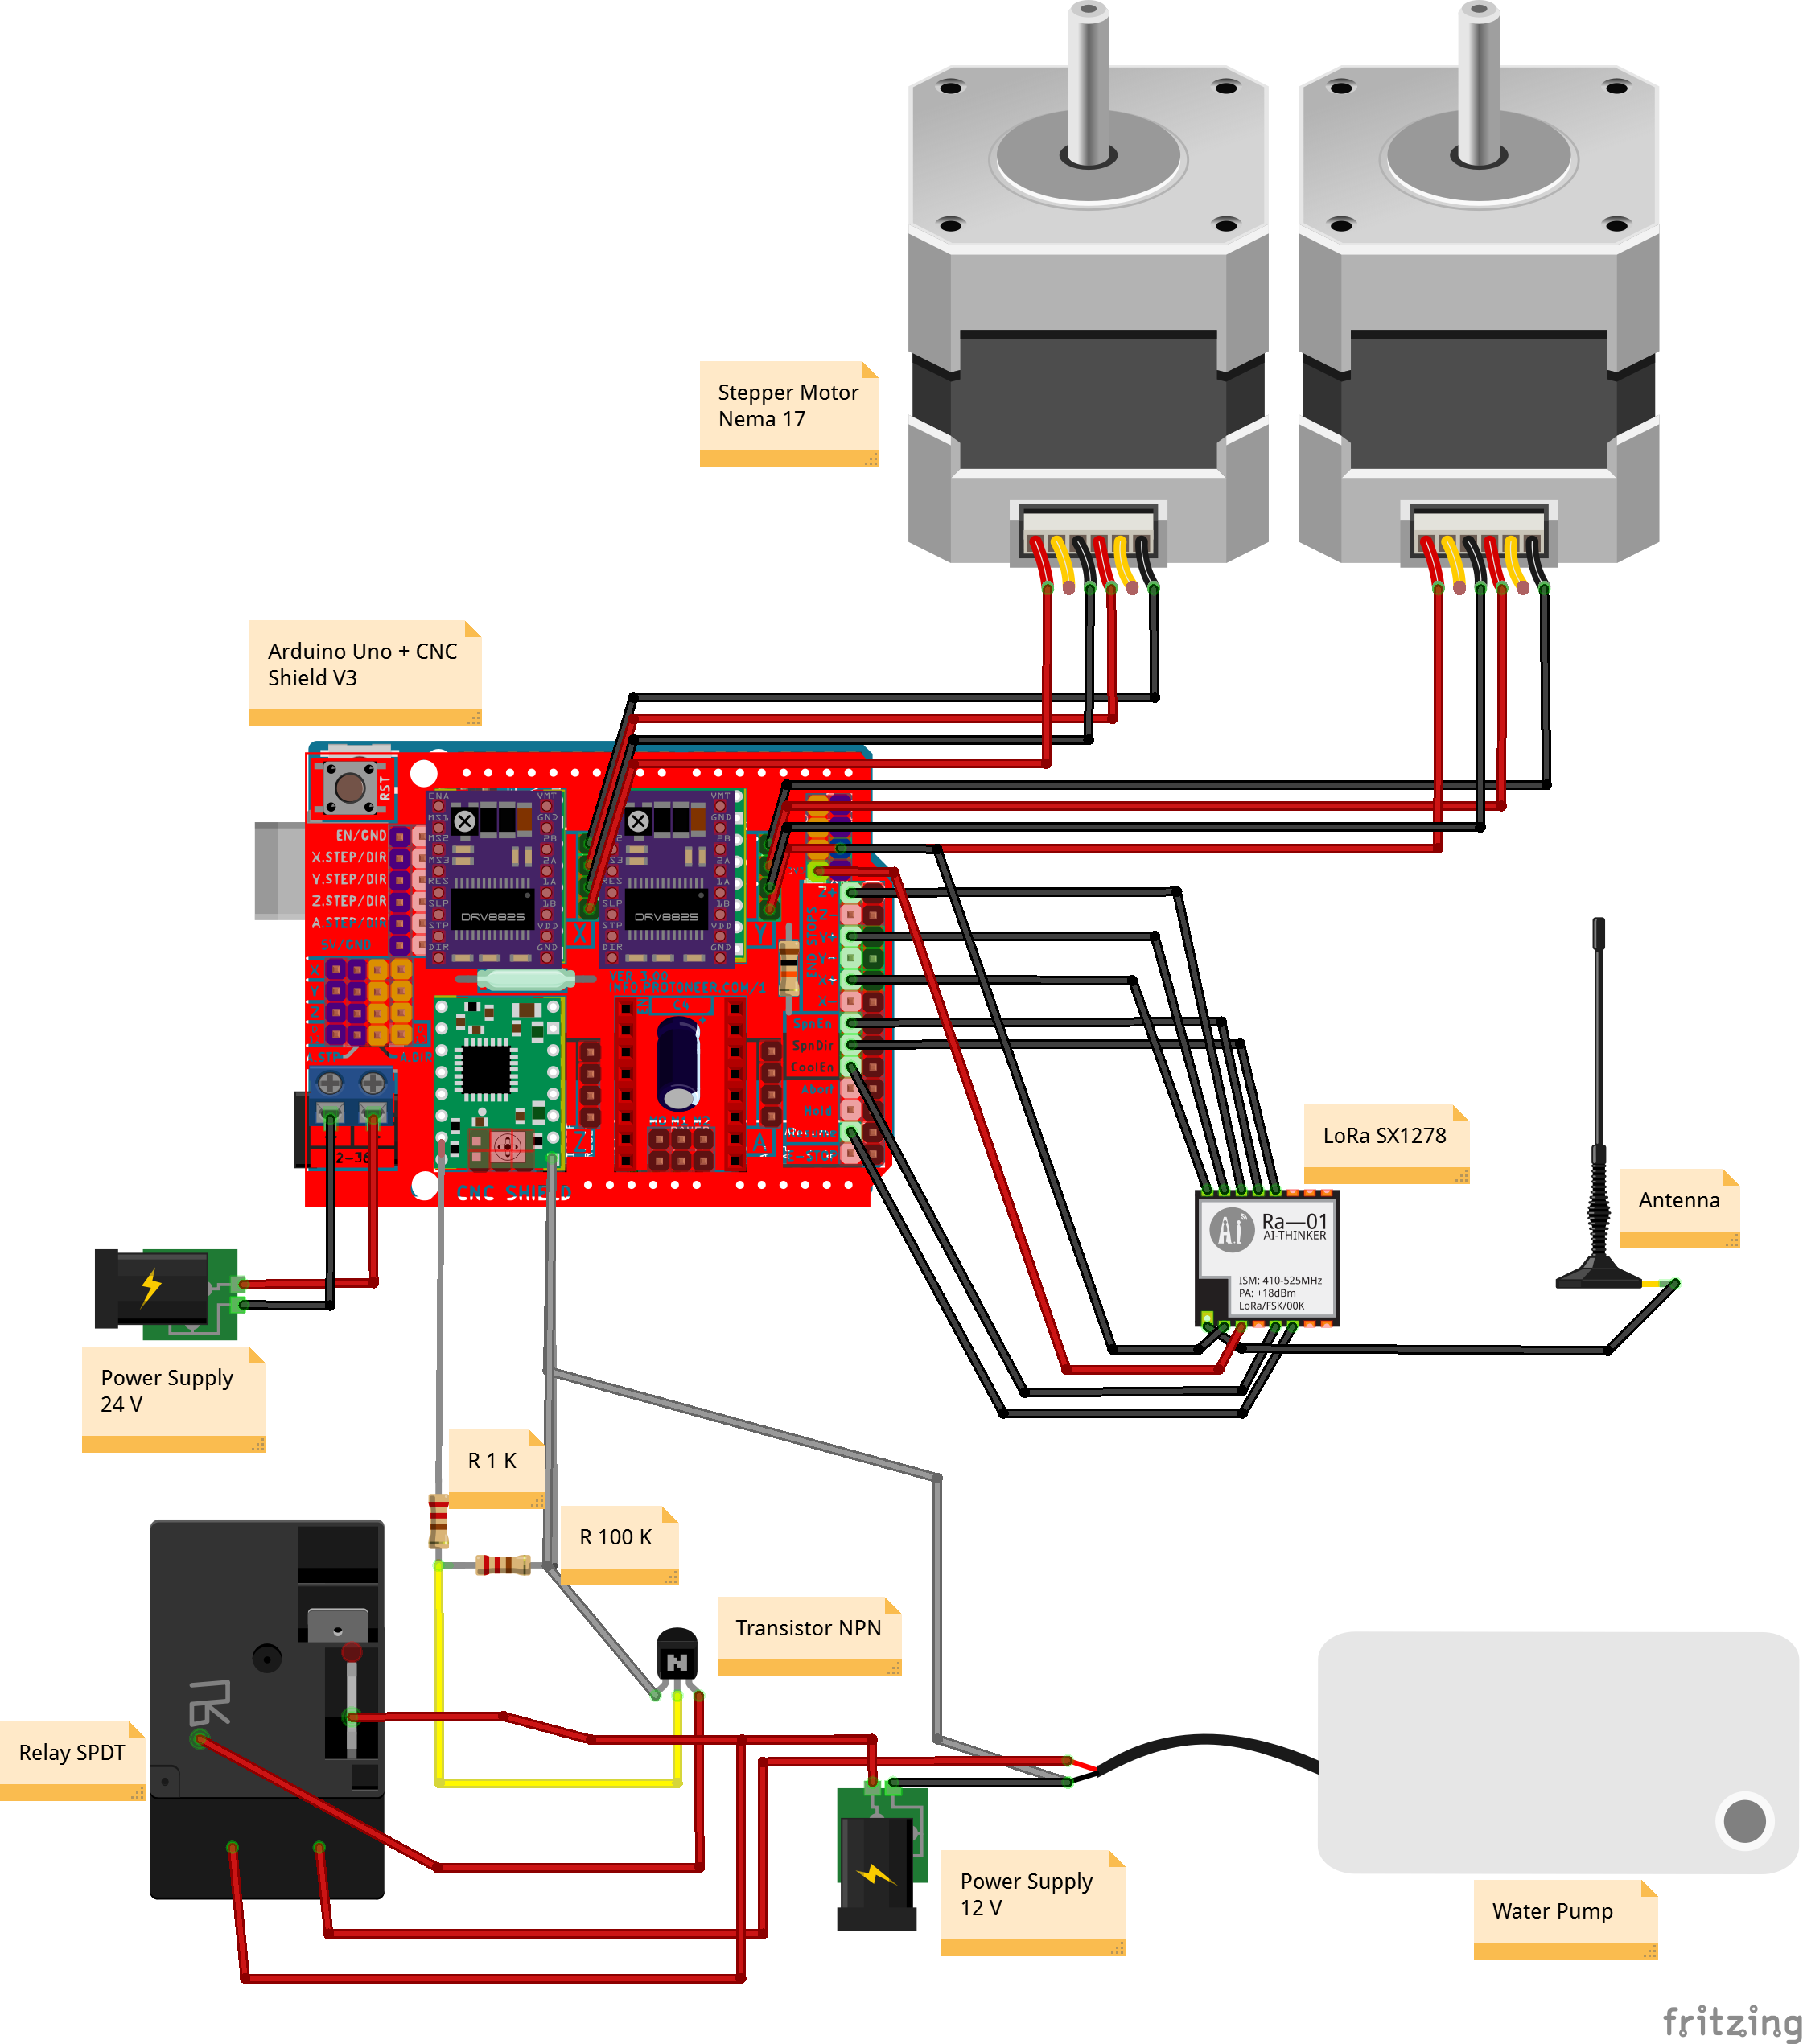
Design and Realization
Electronic Circuit Design

Slide 10
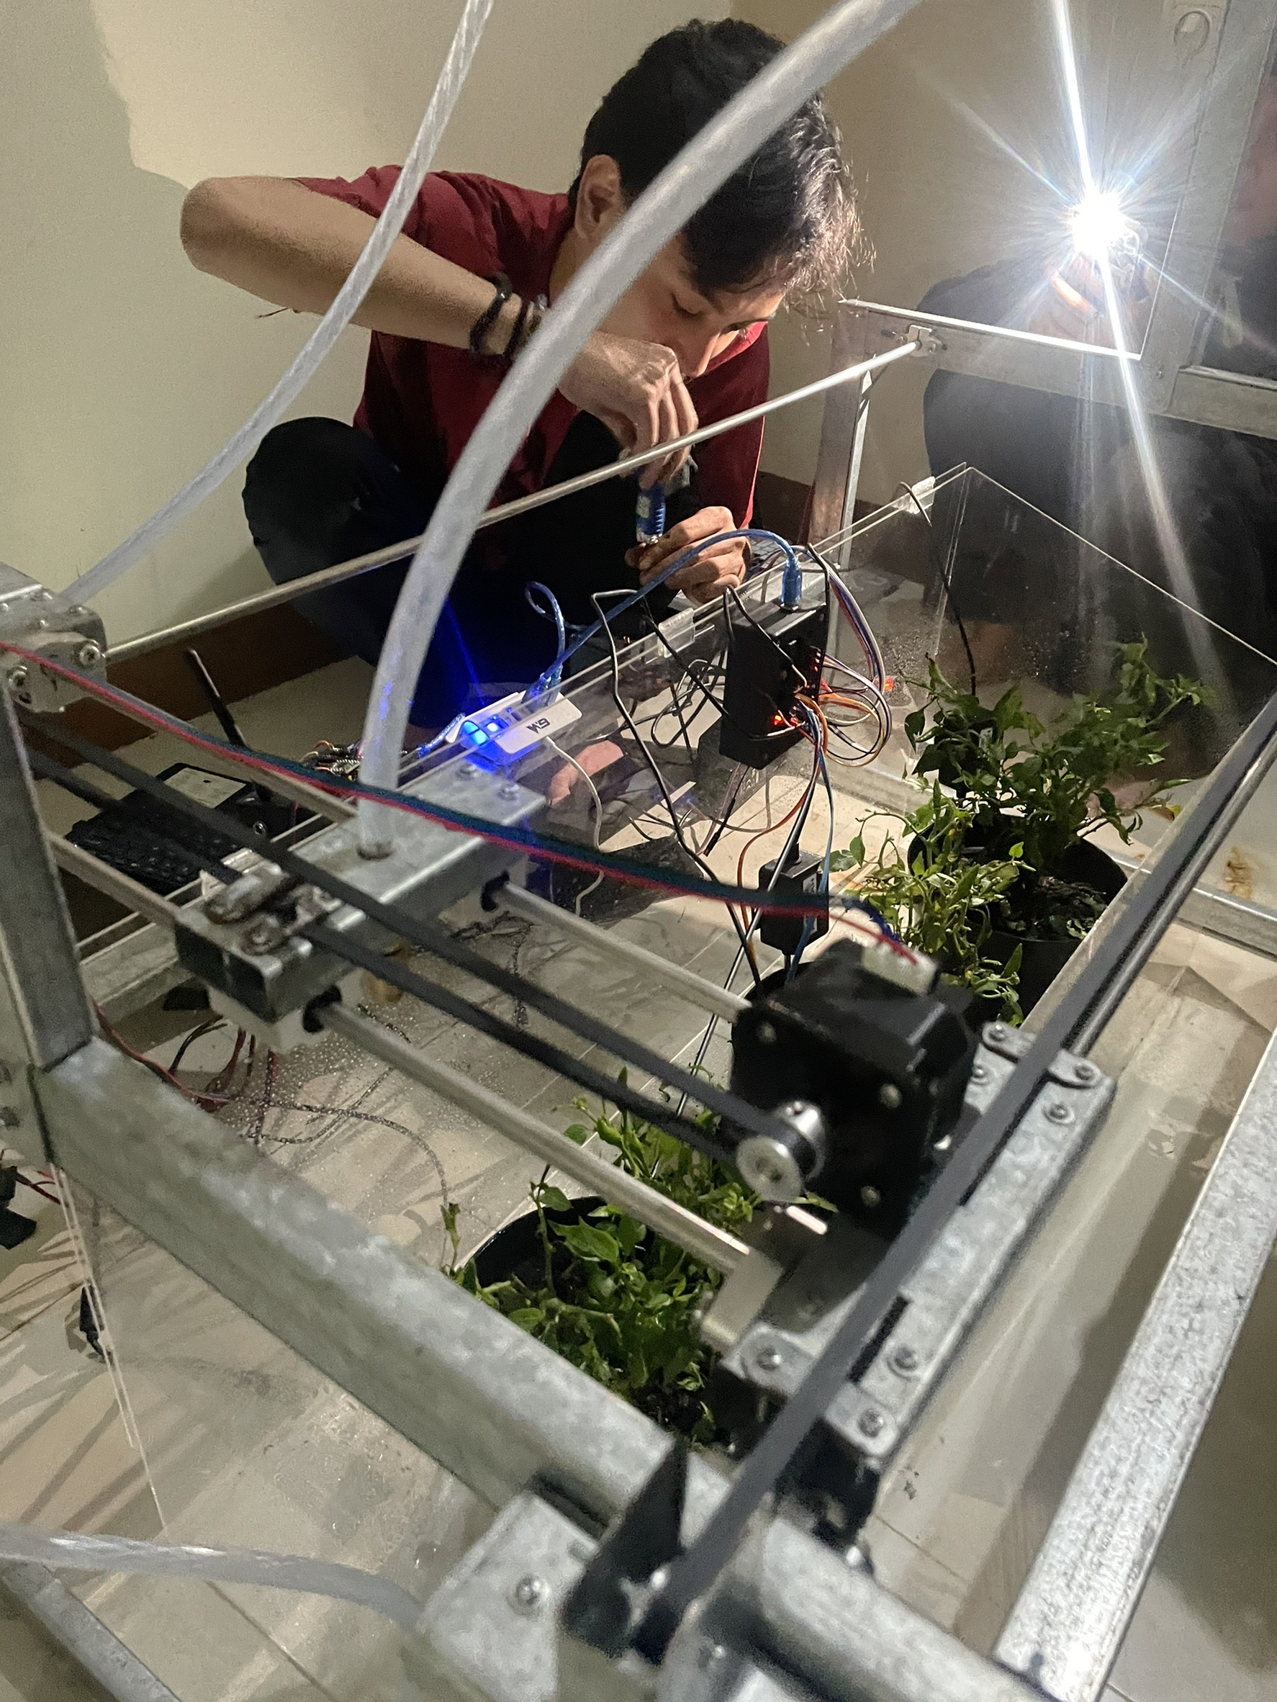
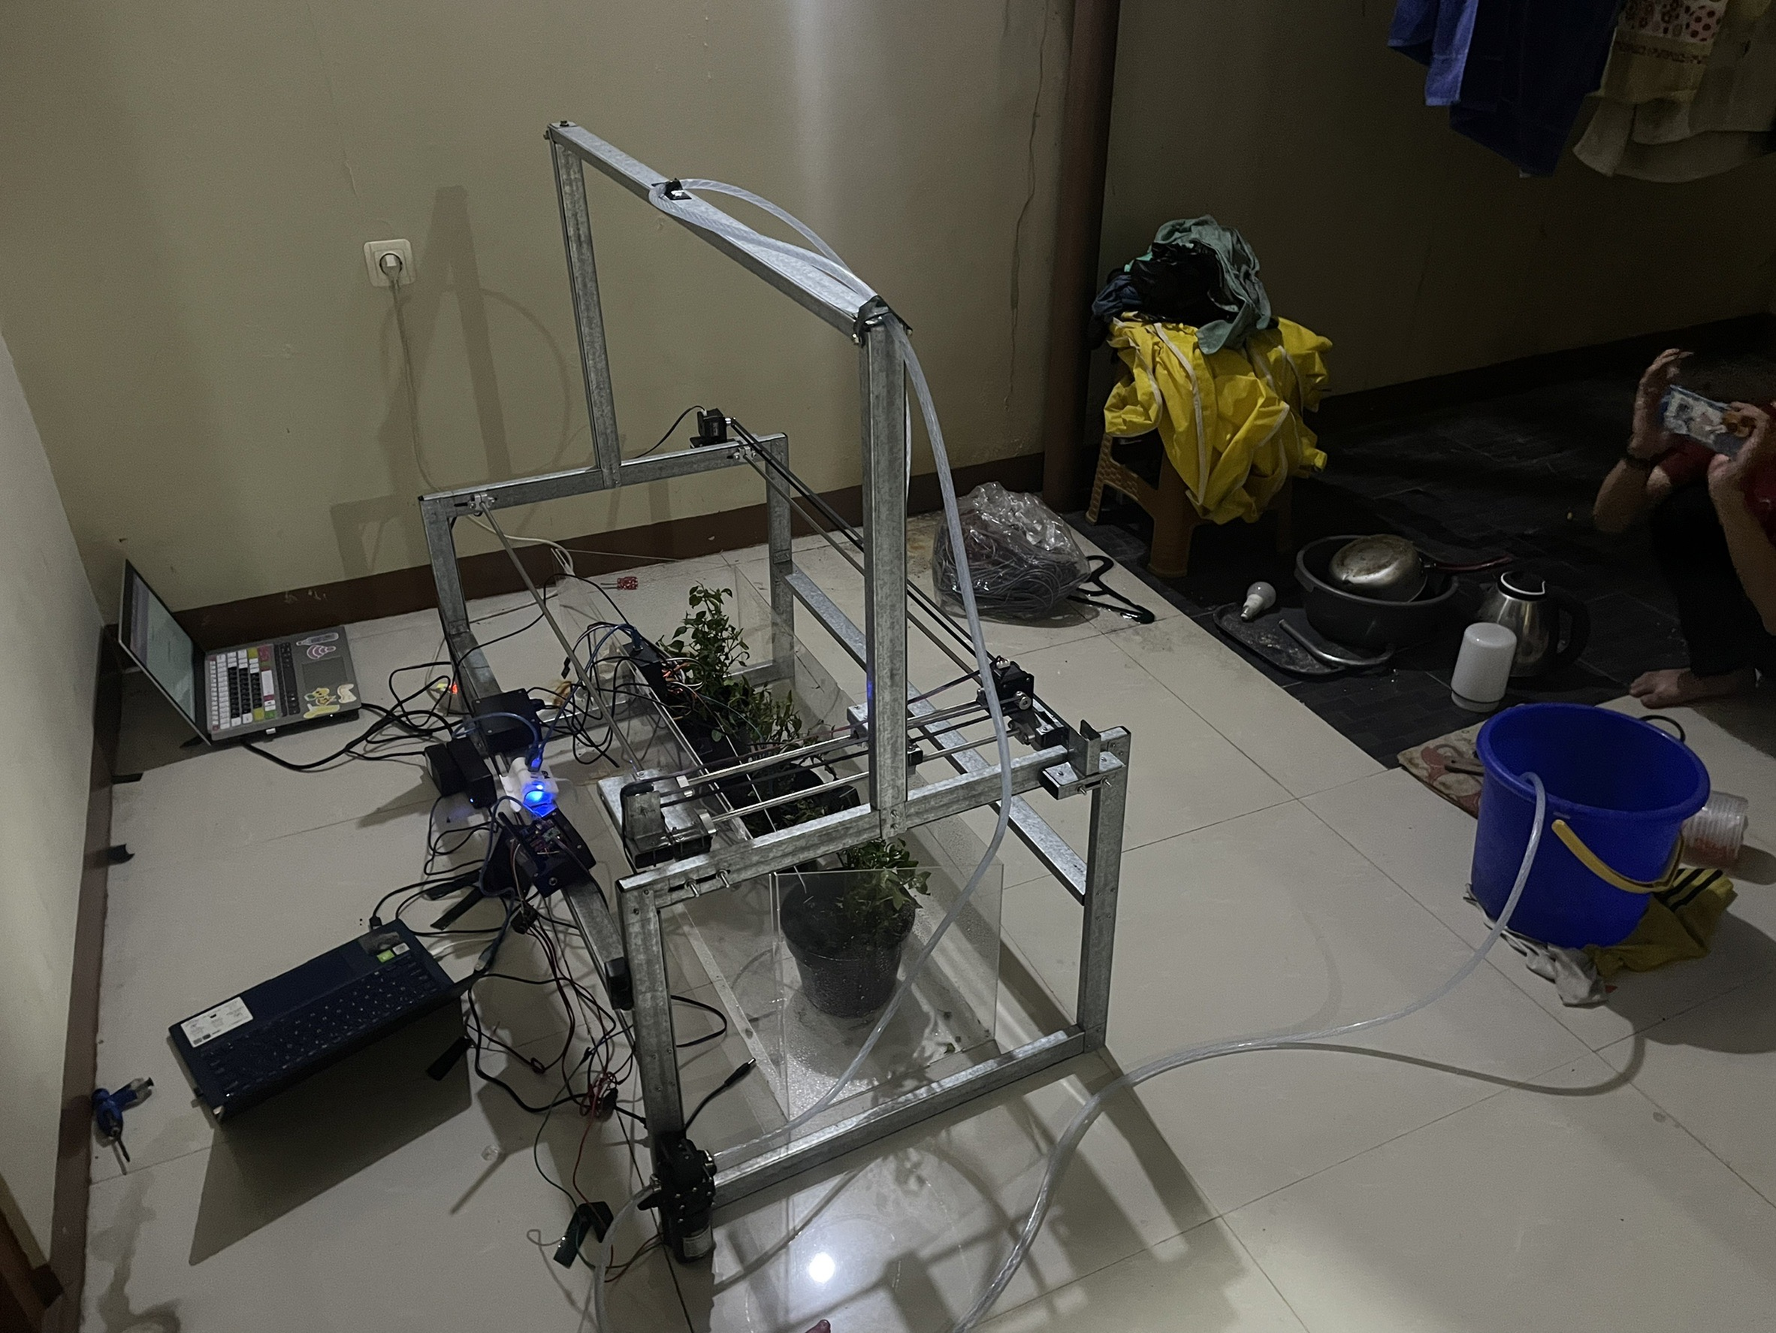
Design and Realization
Result of Realization

Slide 11
Performance Analysis
Position Test
X (cm)
Input (step) | Distance (cm) | Distance per Step (cm)
100 | 2.15 | 0.0215
500 | 10.45 | 0.0209
1000 | 20.45 | 0.02045
2000 | 40.3 | 0.02015
Average Distance per Step |  | 0.0210875
Y (cm)
Input (step) | Distance (cm) | Distance per Step (cm)
100 | 2.1 | 0.021
500 | 10.3 | 0.0206
1000 | 20.2 | 0.0202
Average Distance per Step |  | 0.0206
Position test is carried out to determine the distance traveled by each input step.
We found that X-axis Distance per Step is 0.0210875 cm and Y-axis Distance per Step is 0.0206 cm.
The difference in the value of the Distance per Step is affected by the length of each axis path.

Slide 12
Performance Analysis
Accuration & Repeatability Test
X
Y
No | Supposed Distance (cm) | Real Distance (cm) | Difference (cm) | Accuration (%)
1 | 42.175 | 40.3 | 1.875 | 95.5
2 | 42.175 | 40.3 | 1.875 | 95.5
3 | 42.175 | 40.3 | 1.875 | 95.5
4 | 42.175 | 40.3 | 1.875 | 95.5
5 | 42.175 | 40.3 | 1.875 | 95.5
6 | 42.175 | 40.3 | 1.875 | 95.5
7 | 42.175 | 40.3 | 1.875 | 95.5
8 | 42.175 | 40.3 | 1.875 | 95.5
9 | 42.175 | 40.3 | 1.875 | 95.5
10 | 42.175 | 40.4 | 1.775 | 95.8
11 | 42.175 | 40.3 | 1.875 | 95.5
12 | 42.175 | 40.3 | 1.875 | 95.5
13 | 42.175 | 40.35 | 1.825 | 95.6
14 | 42.175 | 40.35 | 1.825 | 95.6
15 | 42.175 | 40.3 | 1.875 | 95.5
16 | 42.175 | 40.3 | 1.875 | 95.5
17 | 42.175 | 40.3 | 1.875 | 95.5
18 | 42.175 | 40.3 | 1.875 | 95.5
19 | 42.175 | 40.35 | 1.825 | 95.6
20 | 42.175 | 40.3 | 1.875 | 95.5
Average Accuration |  |  |  | 95.53
No | Supposed Distance (cm) | Real Distance (cm) | Difference (cm) | Accuration (%)
1 | 10.3 | 10.2 | 0.1 | 99
2 | 10.3 | 10.3 | 0 | 100
3 | 10.3 | 10.2 | 0.1 | 99
4 | 10.3 | 10.2 | 0.1 | 99
5 | 10.3 | 10.3 | 0 | 100
6 | 10.3 | 10.3 | 0 | 100
7 | 10.3 | 10.2 | 0.1 | 99
8 | 10.3 | 10.2 | 0.1 | 99
9 | 10.3 | 10.2 | 0.1 | 99
10 | 10.3 | 10.2 | 0.1 | 99
11 | 10.3 | 10.2 | 0.1 | 99
12 | 10.3 | 10.2 | 0.1 | 99
13 | 10.3 | 10.1 | 0.2 | 98
14 | 10.3 | 10.2 | 0.1 | 99
15 | 10.3 | 10.3 | 0 | 100
16 | 10.3 | 10.3 | 0 | 100
17 | 10.3 | 10.2 | 0.1 | 99
18 | 10.3 | 10.2 | 0.1 | 99
19 | 10.3 | 10.1 | 0.2 | 98
20 | 10.3 | 10.2 | 0.1 | 99
Average Accuration |  |  |  | 99.15

Slide 13
Performance Analysis
Automation Time Test
No | Target Plant(s) | Algorithm 1 Duration (s) | Algorithm 2 Duration (s)
1 | Plant 1 | 7.5 | 13.22
2 | Plant 2 | 9.25 | 13.22
3 | Plant 3 | 11.22 | 13.22
4 | Plant 1 & 2 | 14.16 | 17.22
5 | Plant 1 & 3 | 16.16 | 17.22
6 | Plant 2 & 3 | 16.2 | 17.22
7 | Plant 1, 2, 3 | 21.22 | 21.22
Total |  | 95.71 | 112.54
Algorithm 1: Nozzle only come to plants that need watering
Algorithm 2: Nozzle come to all plants but do watering only to plants that need watering
Algorithm 1 is more efficient than Algorithm 2 in time consumption but less efficient in program code because it needed 7 voids and will need 14 voids if the number of plants is 4.

Slide 14
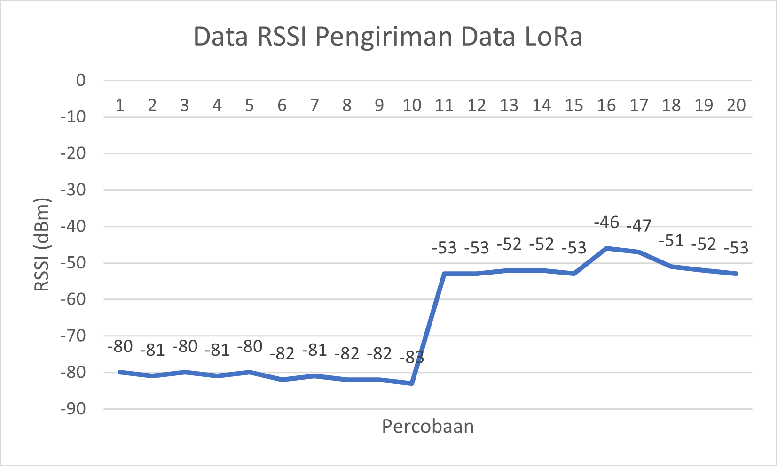
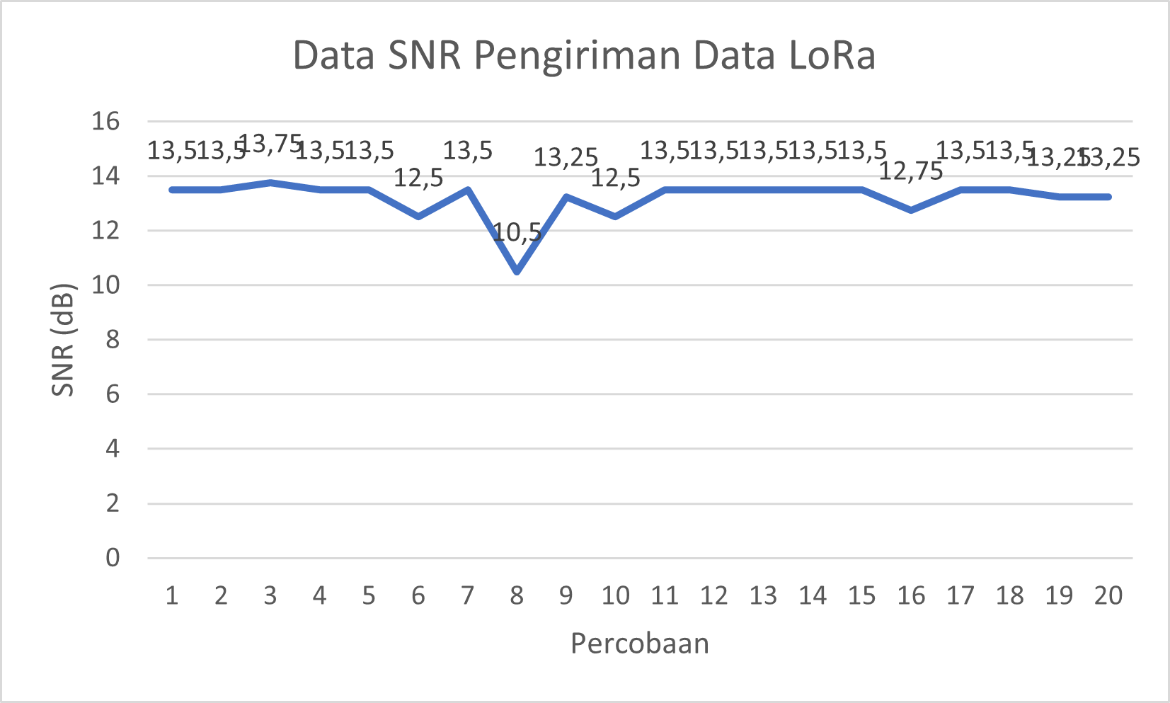
Performance Analysis
Data Delivery Parameter Measurement
Average RSSI of data delivery is -66.2 dBm (good)
and average SNR of data delivery is 13.1875 dB (good)

Slide 15
Conclusion and Suggestions
Conclusions
Suggestions
Smart Greenbox with an IoT-based automation system prototype for chili plants has been successfully built.
The prototype of the automation system can do water or liquid fertilizer to plants programmatically or automatically based on input from sensors.
The average accuracy of the prototype automation system is 95.53% for the X-axis line and 99.15% for the Y-axis line.
The performance of the automation system prototype is influenced by the quality of the materials, the quality of the components, and the neatness of the construction.
The average RSSI and SNR values ​​of LoRa data transmission in this study are in the good category with values ​​of -66.2 dBm and 13.1875 dB.
Ensure that the materials used are free of defects so that the automation process runs smoothly.
Accurately assemble the framework of CNC machines and tools so that distance calculations can be easier and more correct.
The prototype of the automation system can be added with an additional nozzle or use a triangular nozzle in order to automate watering and also the application of liquid fertilizer.
Testing can be done with more experiments in order to obtain a more promising level of accuracy.

Slide 16
THANK YOU

